Slide 2
GitHub Commits (Uploading Results)
Notes:
Assumes Activity 1: Running R Code has been completed

Slide 3
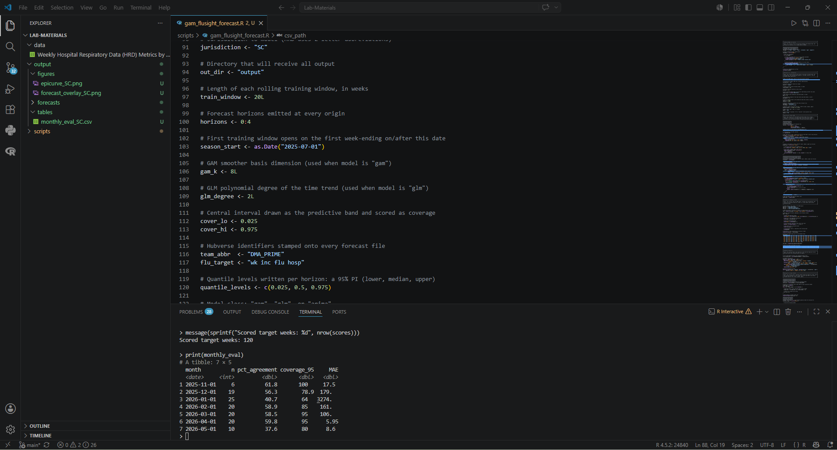
After completing Activity 1, you should now see an output folder, along with various figures and data files. We are going to walk through how to “push” or upload them to the course GitHub repository and your copy (fork). We will cover two ways of pushing to GitHub.

Slide 4
Commit via VS Code

Slide 5
Step 1: Open Source Control
The first thing we need to do is open the Source Control menu. This is the menu that allows us to version-control our changes, and upload the changes to our local repository in GitHub. To open the control menu, press: CTRL + SHIFT + G

Slide 6
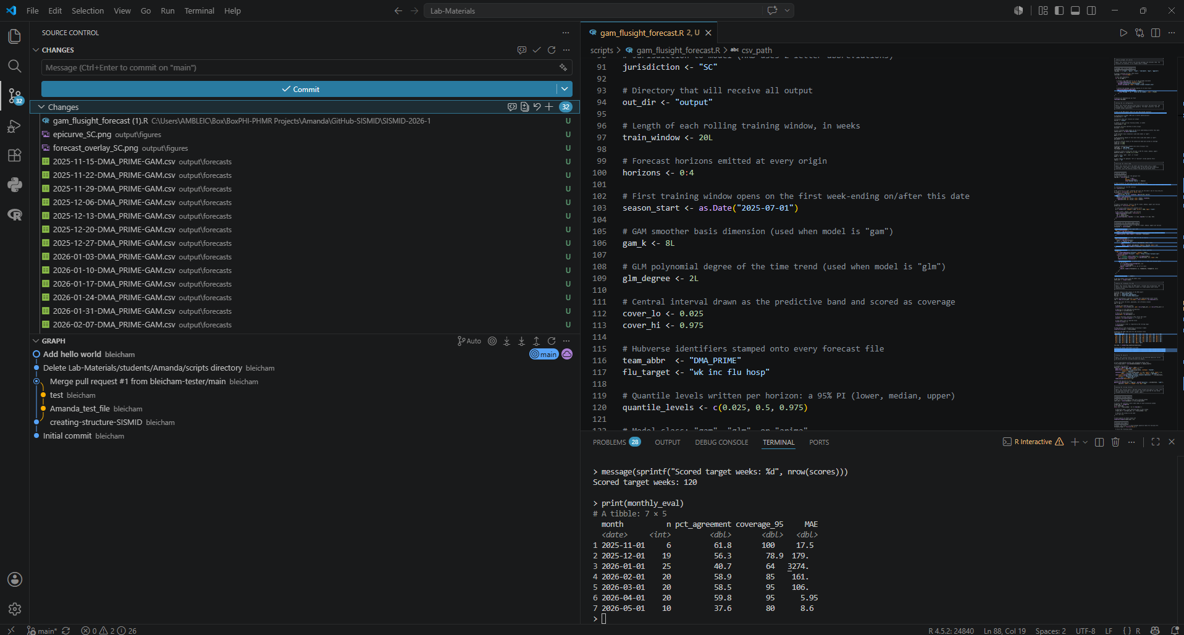
Source Control Panel
The VS Code Source control panel is your visual hub for Git (versioning Software from earlier). It shows all of our modified files at a glance, grouped into ‘Changes’ (edits not yet queued) and ‘Staged Changes’ (edits ready for upload). It Is where we will track what we change, decide what to save, and record it to our projects history.
Step 2: Staging the Files
Staging files is how we tell Git which changes (files) to include in our next commit or upload. For this exercise, we will upload all files. In VS Code, this is achieved by clicking the + next to the ‘Changes’ drop down.

Slide 7
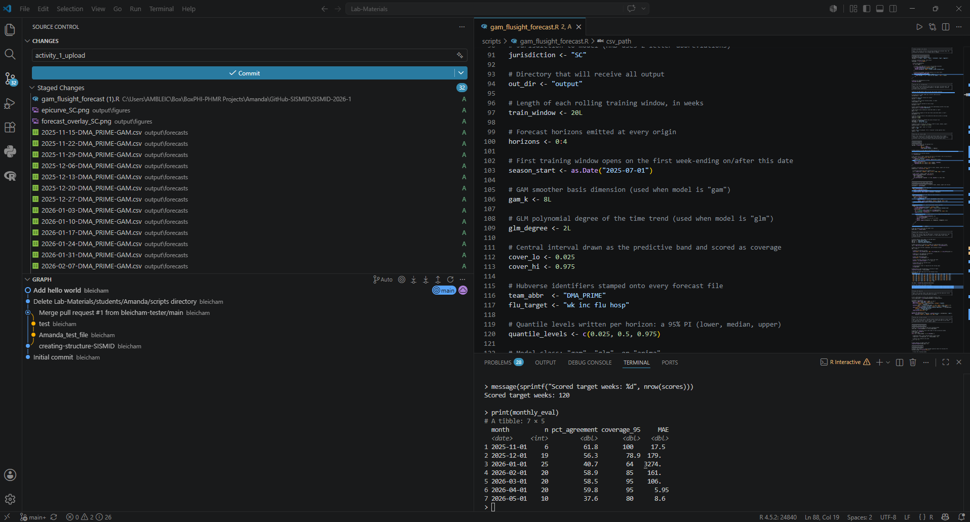
Step 3: Commit (Upload) to GitHub
After completing Step 2, you should now see that all of your changed files appear under the ‘Staged Changes’ drop down, rather than the ‘Changes’ drop down. Now, to start the process of moving these files to your GitHub repository (fork), we first need to provide a Commit message. This is a note or brief phrase indicating the change that is occurring with this upload. For our activity, we will type:
activity_1_upload
Finally, click Commit to begin the upload process.

Slide 8
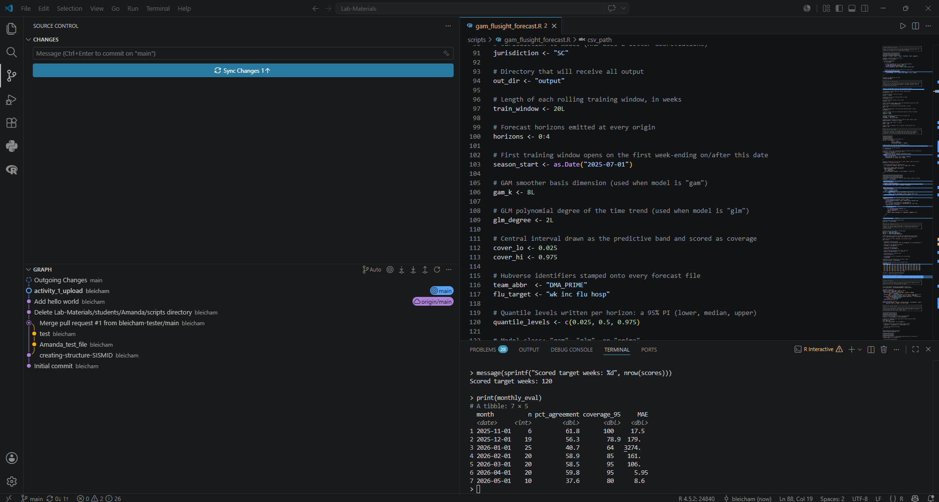
Step 4: Sync Changes
Syncing keeps your local work and the remote repository (GitHub) in agreement. When you click Sync Changes, VS Code does two things in one step: it pushes your committed changes up to the remote and pulls down any new changes made directly in GitHub. You'll find it at the bottom status bar or in the Source Control panel, often showing arrows with numbers, ↓ for commits waiting to come down, ↑ for commits waiting to go up. Committing saves your work locally; syncing is what shares it and brings you up to date. To synch your new changes, click Sync Changes.

Slide 9
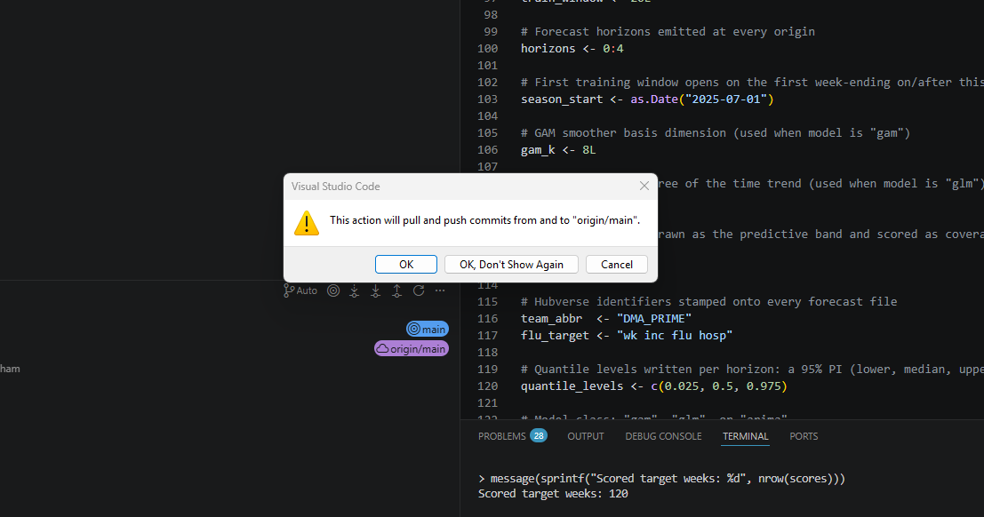
Step 5: Confirming Upload to the Main Branch
The main branch is your repository's official, up-to-date version of your project. It's what people see by default and what other branches typically merge back into once their changes are ready. Think of it as the trunk: experimental work happens on separate branches, but main holds the version you consider stable and current.
Click OK.

Slide 10
Commit via GitHub
*Does not require Git download

Slide 11
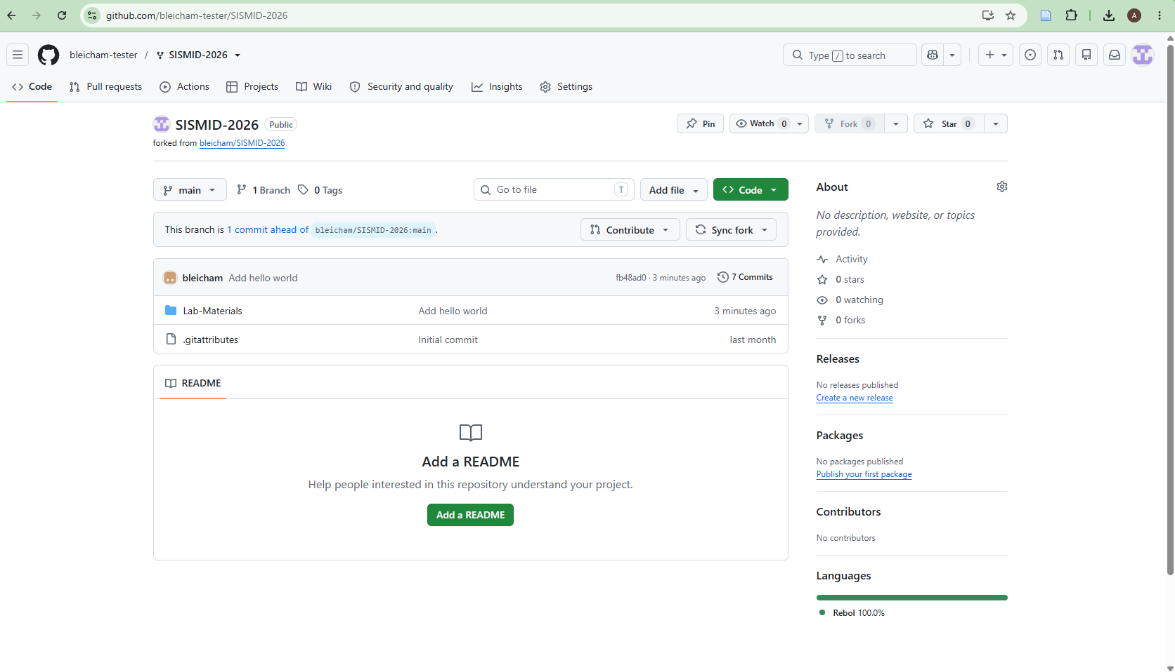
Step 1: Navigate to your GitHub Fork
We can also upload or commit our results via GitHub directly. This circumvents the need for the Git download we discussed earlier but takes a bit more time to upload files. First, you will want to navigate to your GitHub fork.

Slide 12
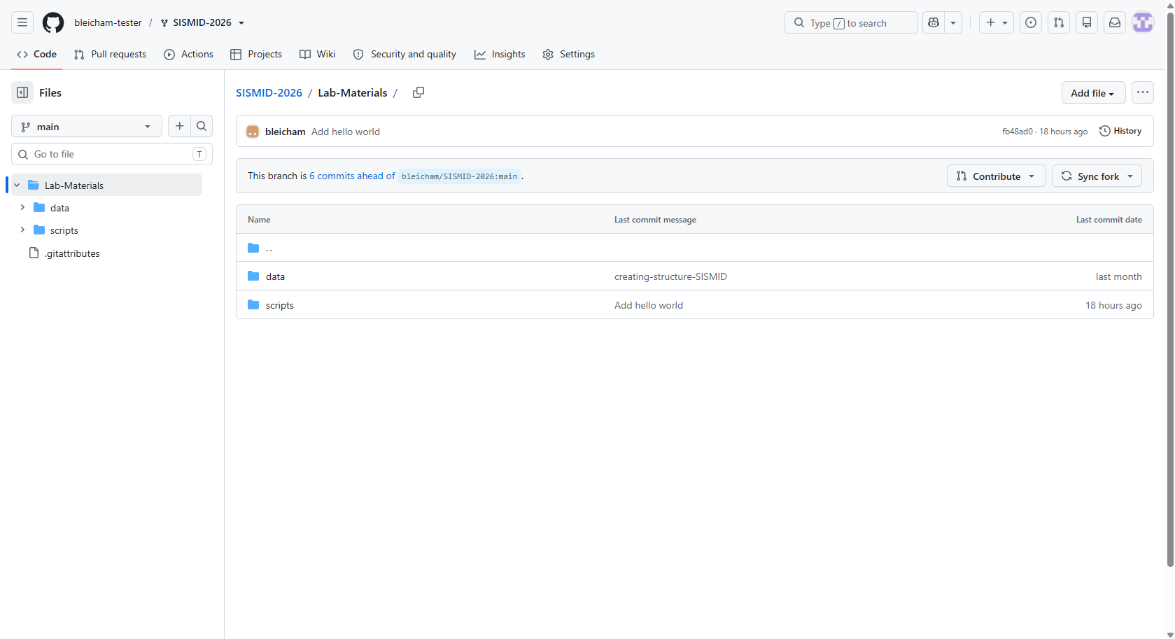
Step 2: Navigating to the Lab-Materials Folder
We want to keep our outputs within the Lab-Materials folder. Therefore, prior to adding our files to GitHub, we need to navigate to the Lab-Materials folder.

Slide 13
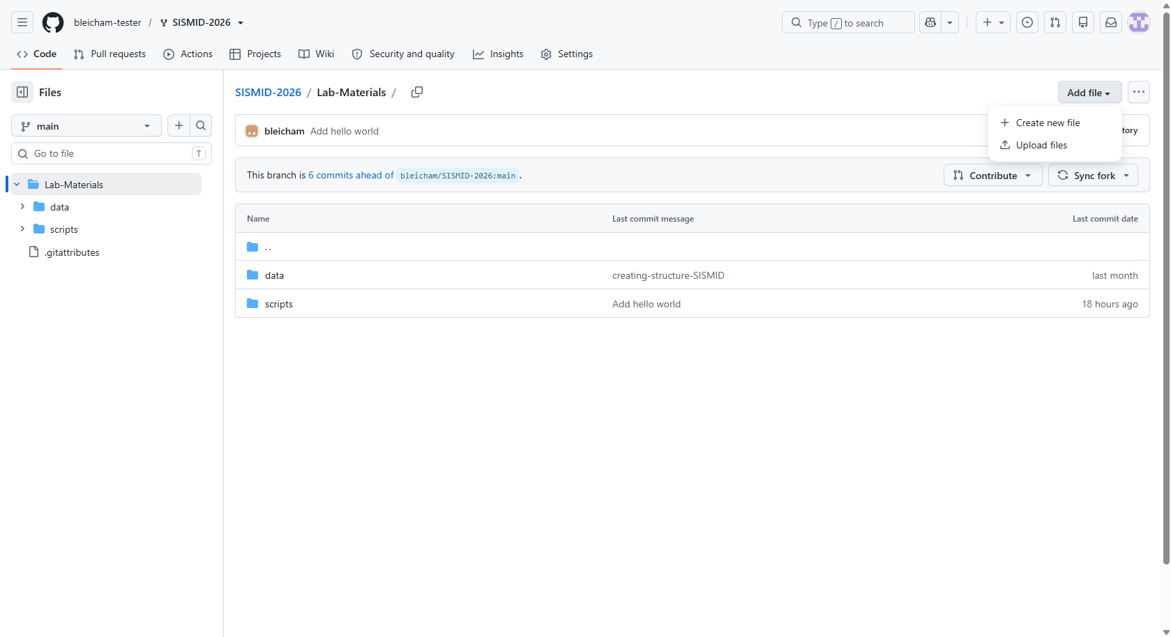
Step 3: Starting the Process of Uploading files
To start the process of uploading our files, we first are going to click the Add file button in the upper right-hand corner.
As we already have the files on our local machine we want to upload to GitHub, we need to click Upload files rather than Create new file. This tells GitHub that we want to search our local machine rather than create something directly in the GitHub.
Notes:
Way 2

Slide 14
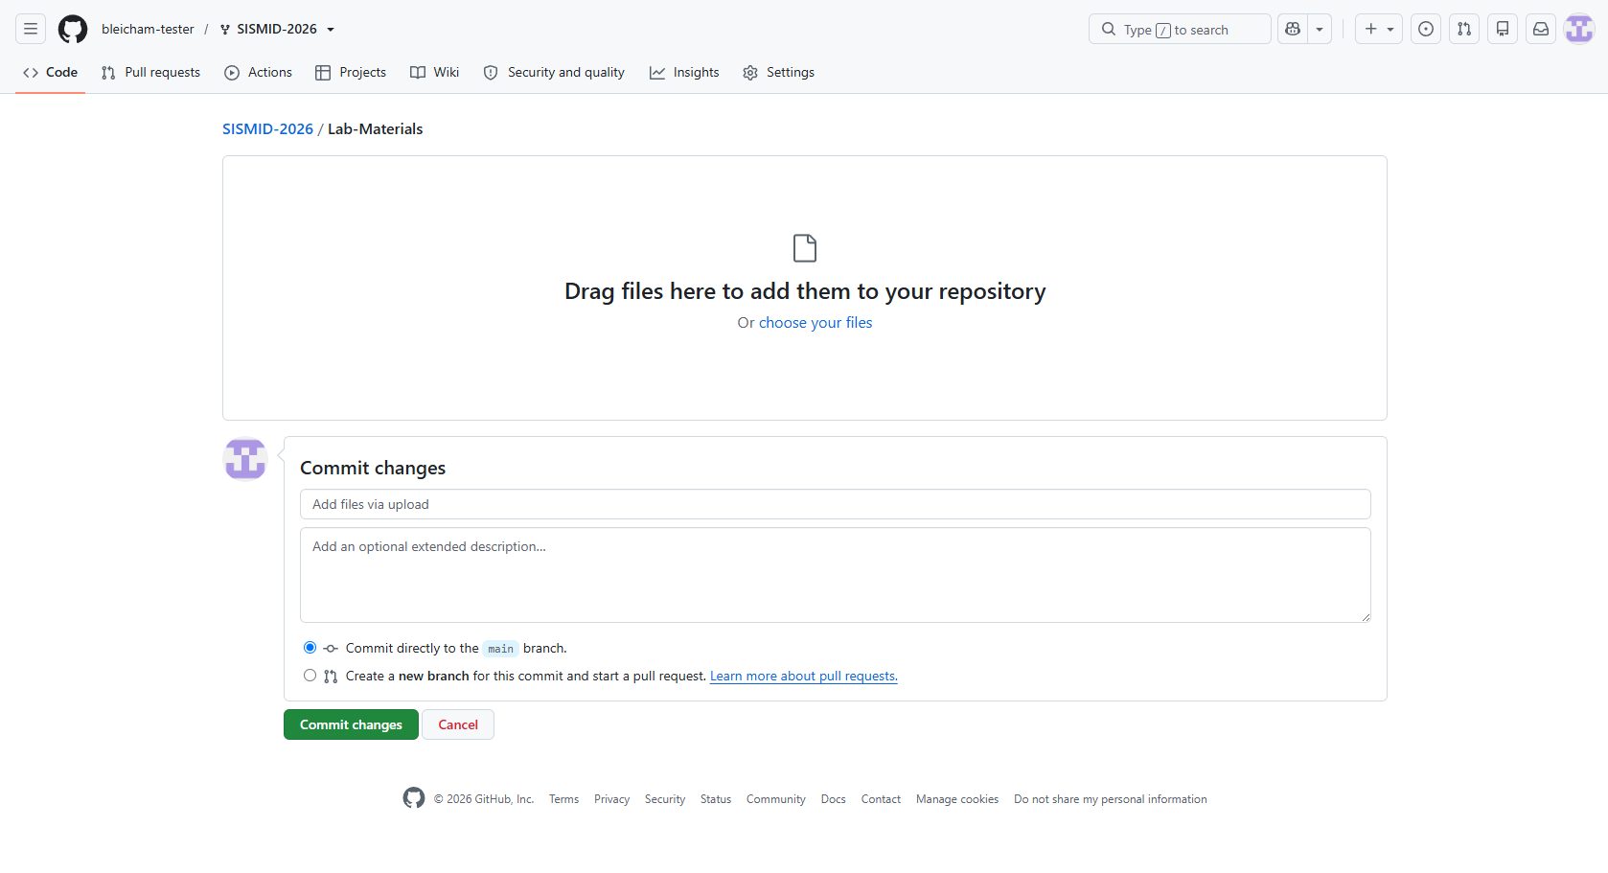
Step 4: Uploading the files
To upload files, we are going to first click Choose your files. This will open our file explorer and allow us to drag over our entire output folder. GitHub does not allow you to select an entire folder to upload, only individual files. It will however let you drag over an entire folder, which is what we will do for this activity.

Slide 15
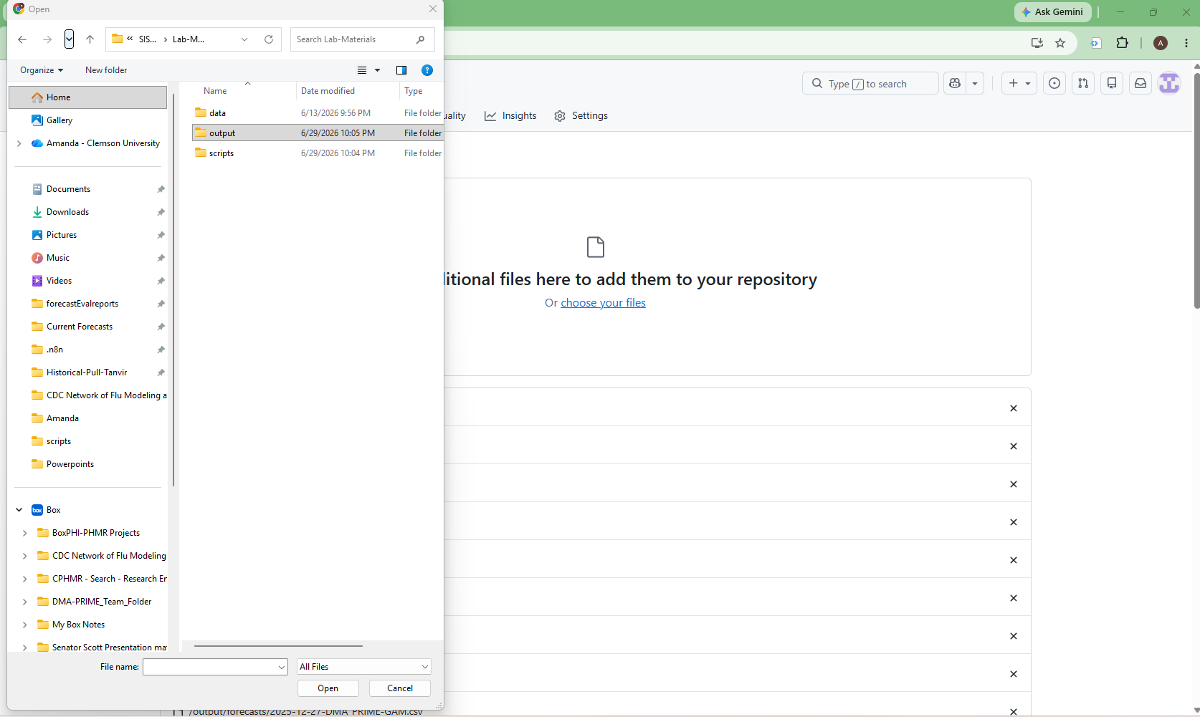
Step 4: Dragging the folder
As discussed on the previous slide, we want to drag our output folder to GitHub. This ensures that the entire folder moves, and all files within the folder stay within it for the move.
To drag the folder, right click, and move your curser over the Drag additional files here to add them to your repository rectangle on GitHub.

Slide 16
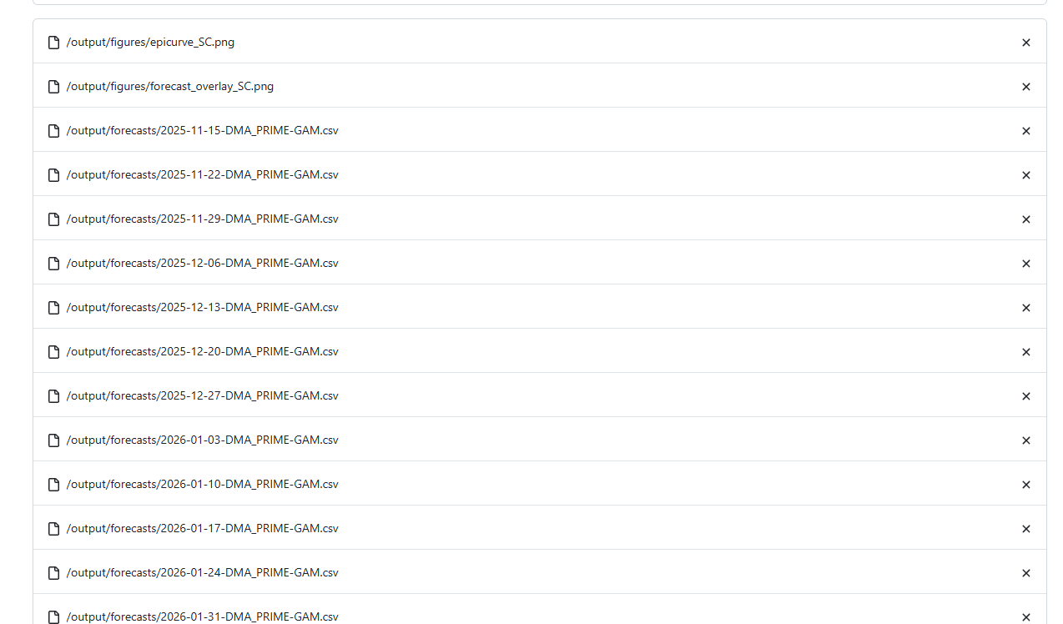

Slide 17
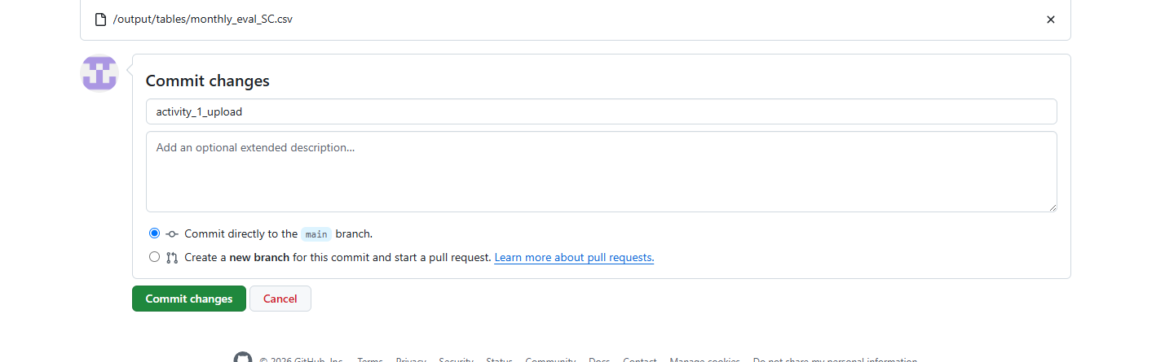

Slide 19
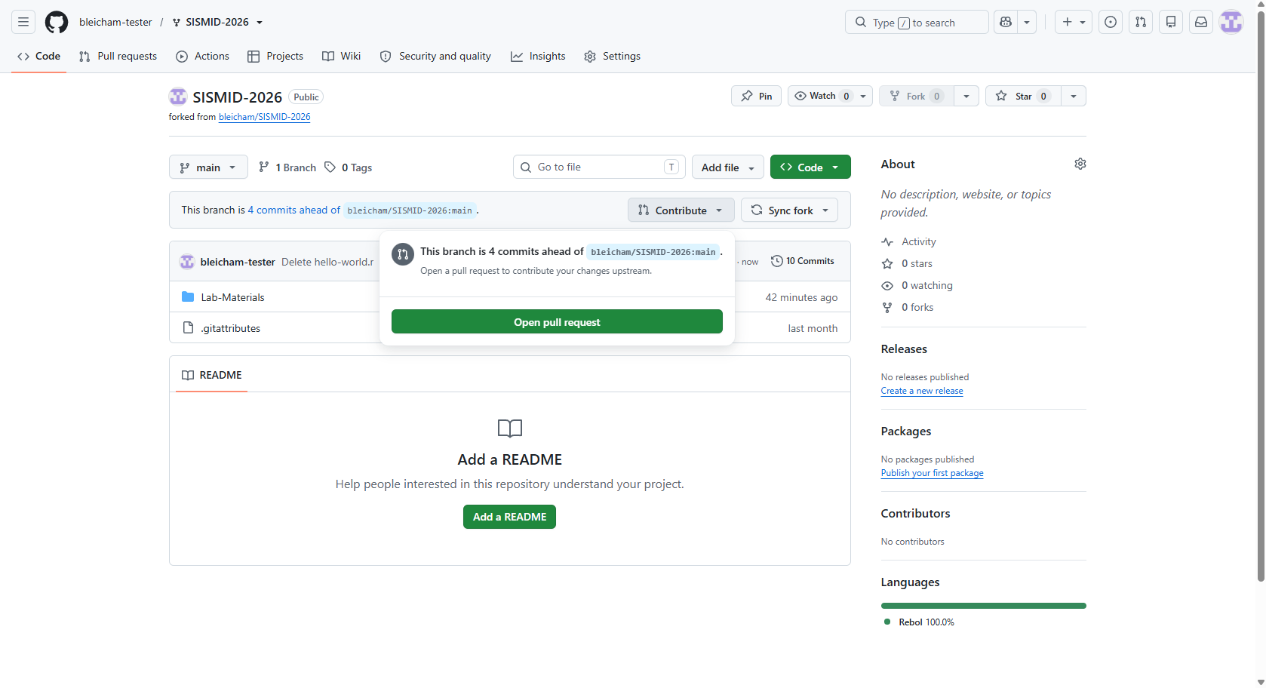

Slide 20
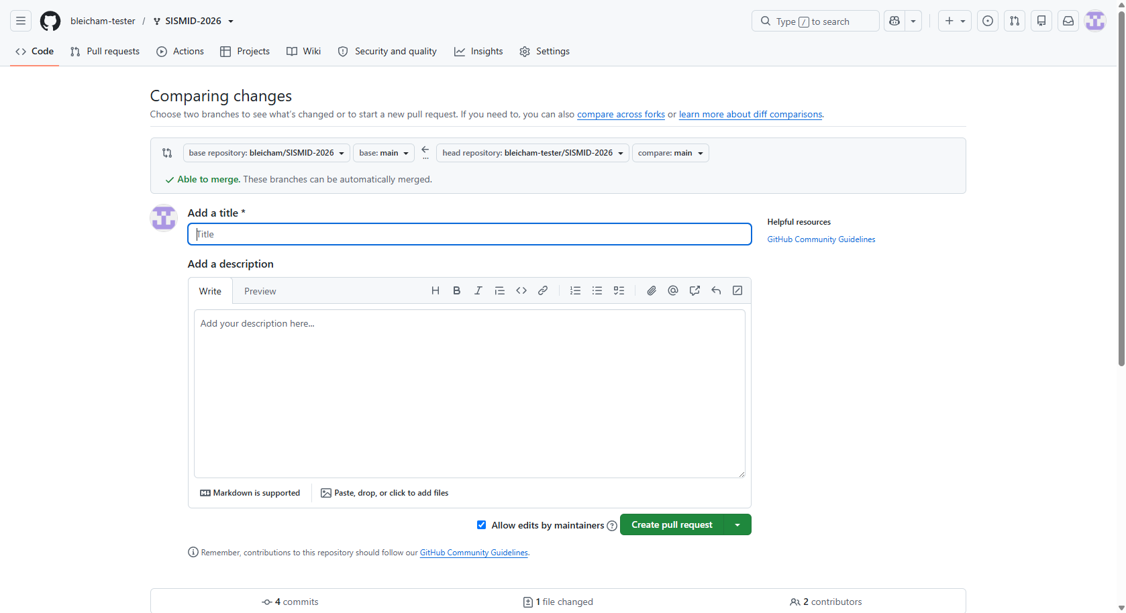

Slide 21
When to Push
Push after completing each phase of the lab. Each push is a checkpoint — the agent verifies your progress.
After Data Cleaning
rules.md, scripts/01_cleaning.R, output/cleaned_flu_admissions.csv
After Visualization
Updated rules.md, scripts/02_visualization.R, output/figures/*.png, output/*.csv
After Feature Selection
Updated rules.md, scripts/02b_feature_prep.R, output/modeling_data.csv
After Modeling & Forecasting
Updated rules.md, scripts/03_modeling.R, scripts/04_forecasting.R, results/forecasts*.csv
After Evaluation
Updated rules.md, scripts/05_evaluation.R, output/eval_*.csv, output/figures/*.png

Slide 22

Step 7
Agent Checks Your Work
All checks passed
✕
Some checks failed
✓ Required files exist
✓ Output format is correct
✓ Change log updated
→ PR auto-merges!
✕ Missing output files
✕ Wrong CSV format
→ Agent leaves feedback
→ Fix locally, push again
If checks fail, don't panic:
Read the agent's feedback on the PR page → fix the issue in VS Code → commit & push again → the agent re-checks automatically. No new PR needed.

Slide 23
When Checks Fail
Don't panic. Failing checks are a normal part of the workflow. The agent tells you what's wrong.
1
Read the feedback
The agent posts a comment on your PR explaining what failed.
2
Fix it locally
Go back to VS Code, make the fix, re-run your script.
3
Push again
git add, commit, push — to the same branch. The PR updates automatically.
4
Agent re-checks
The checks run again on your updated code. No new PR needed.

